Slide 2
Benefits of Using Visual Aids
Visuals can make ideas more clear
They can increase interest in the topic
They help the audience remember your information
They increase your credibility
They may help you be more persuasive (if persuading is your general purpose)
In the coming pages, an example of a less-than-effective visual aid and its effects will be explained, showing how the visual fails each criterion.

Slide 3
Bad Visuals=Bad Outcome
http://www.who.int/csr/disease/ebola/put_on_ppequipment.pdf?ua=1
http://www.cdc.gov/vhf/ebola/pdf/ebola-lab-guidance.pdf
These two posters were given to healthcare providers during the 2014 Ebola outbreak. The first one is from the World Health Organization; the second is from the US Centers for Disease Control and Prevention.
Keep in mind that these were supposed to be the go-to reference for any healthcare worker who suspected that a patient may have Ebola.
These posters could be the difference between life and death.

Slide 4
Bad Visuals=Bad Outcome
Put yourself in the place of a nurse who is seeing a patient bleeding out of every body opening while vomitting profusely.
Before deciding how to proceed, the nurse needs to know if this could be Ebola and how to prepare for a possible Ebola case.
All the while, the patient is sitting in a room, bleeding, vomiting . . . Dying.
The nurse’s only resources are these posters.
If you were the nurse, would you have time to read through all of this information to figure out how to help the patient? Keep in mind, the patient is literally leaking out fluids that could be contaminated with one of the most deadly viruses known to humanity . . .

Slide 5
Bad Visuals=Bad Outcome
This is the very situation that happened at a Dallas, TX, hospital. Two nurses were infected with Ebola because just hanging a too-detailed poster did not give them adequate preparation for dealing with an Ebola patient, and with a patient dying in front of them, the posters were not accessible enough to read quickly and efficiently.
On the next slide, we will cover how the posters fail each criterion.

Slide 6
Bad Visuals=Bad Outcome
Clarity: There was simply too much information and too poor of drawings for the information to be clear. While people with a lot of time can read through everything, those pressed for time need a quick reference. This is too dense to be clear.
Interest: Healthcare workers were interested in Ebola, but the information was presented in a way that did not assuage their fear or curiosity.
Retention: The way that the information is presented makes it nearly impossible to remember all steps, particularly if lives are on the line and people are bleeding out right in front of you.
Credibility: The WHO and CDC are credible, but they did not present the information in a way that would allow others to adopt their credibility through implementing the steps.
Persuasion: Many could argue that the posters actually served to undercut the urgency of the Ebola situation. If the situation was as dire as many said, then why on earth would the posters be so inaccessible?

Slide 7
Kinds of Visual Aids
Objects & models
Photos & drawings
Graphs
Charts
Video
The speaker
Presentation technology

Slide 8
Our Class
For demonstrative speech, objects, models, photos, and the speaker him/herself are most often used
Keep in mind that your visuals make this speech as they actually show the audience how to do the process you are explaining
For the informative speech, photos, graphs, charts, and PowerPoint are the most often used
For the persuasive speech, PowerPoint is used most often, followed by graphs, charts, and photos

Slide 9
Photos & Drawings
Enlarge for audience
Avoid passing
Display with presentation technology

Slide 10
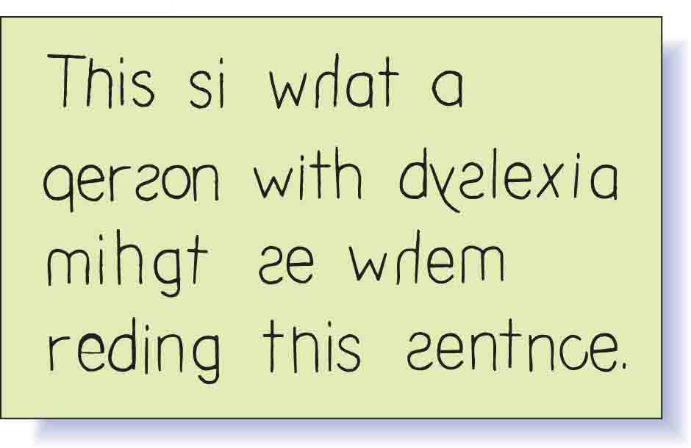
Photos & Drawings

Slide 11
Graphs
Show statistical trends & patterns

Slide 12
Line Graph
Uses one or more lines to show changes over time

Slide 13
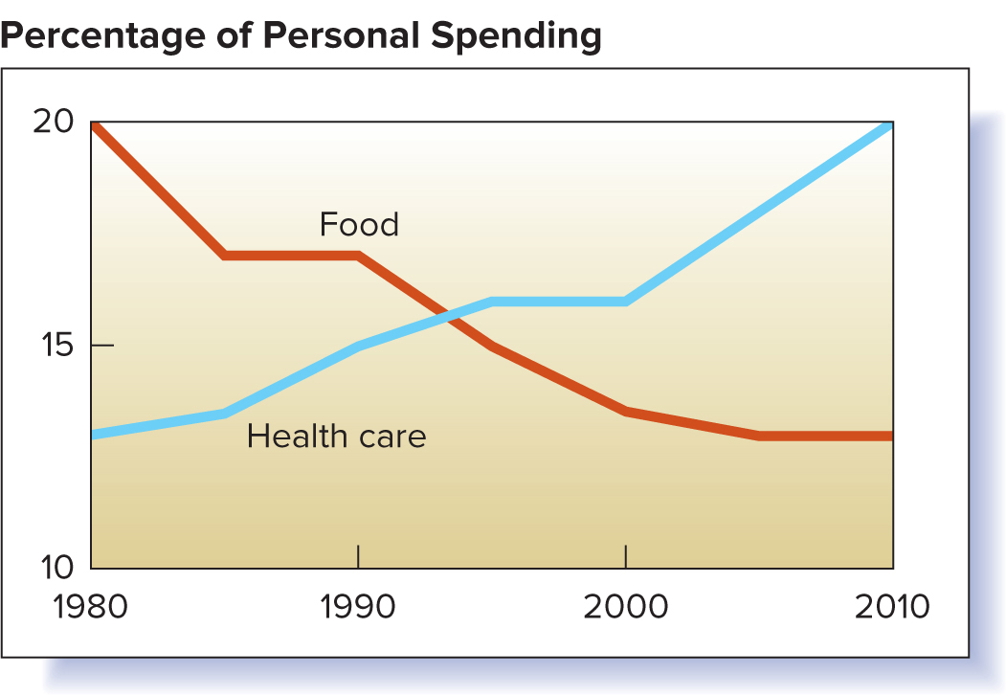
Line Graph

Slide 14
Pie Graph
Highlights segments of circle to show distribution patterns

Slide 15
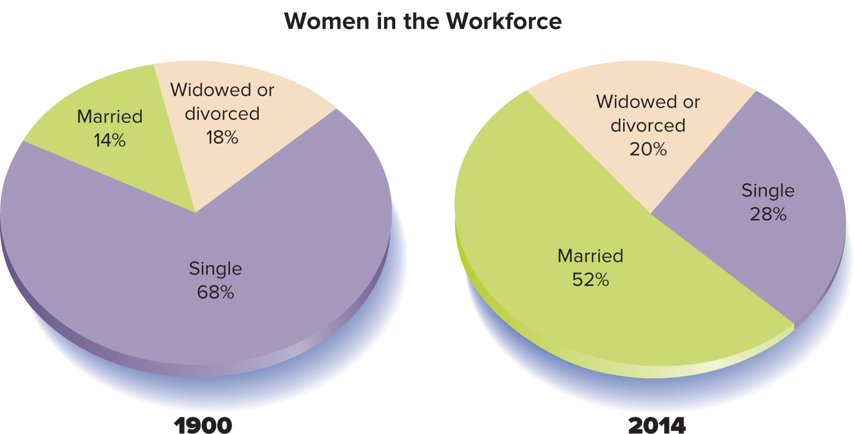
Pie Graph

Slide 16
Bar Graph
Uses vertical or horizontal bars to show comparisons

Slide 17
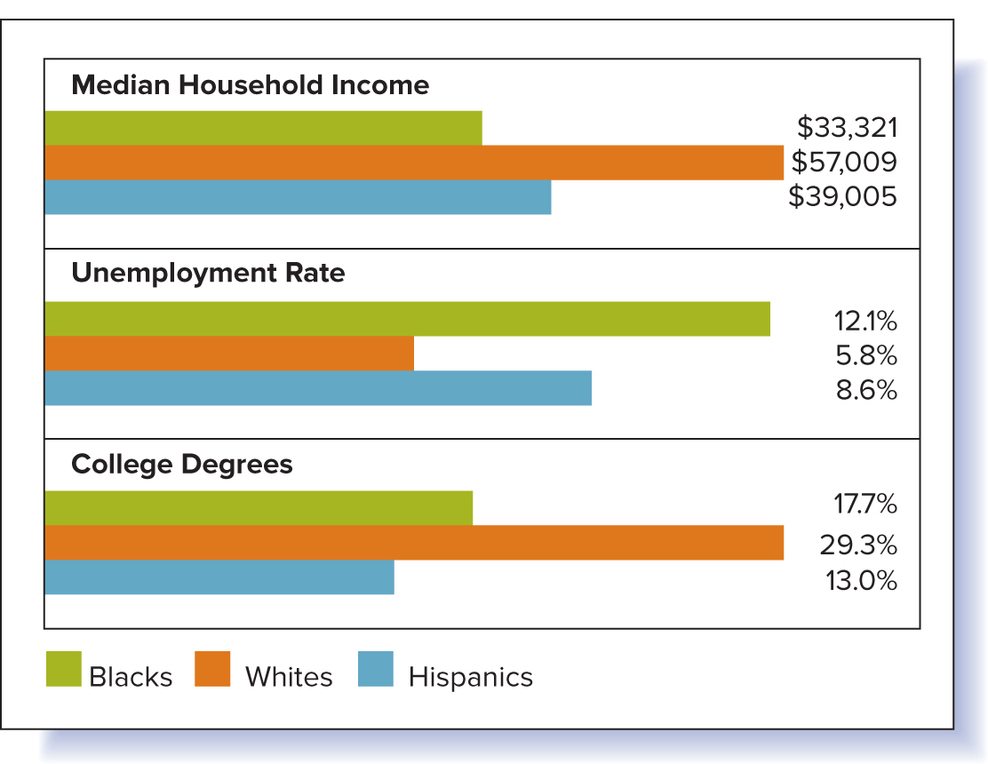
Bar Graph

Slide 18
Charts
Summarize large block of info, usually as list

Slide 19
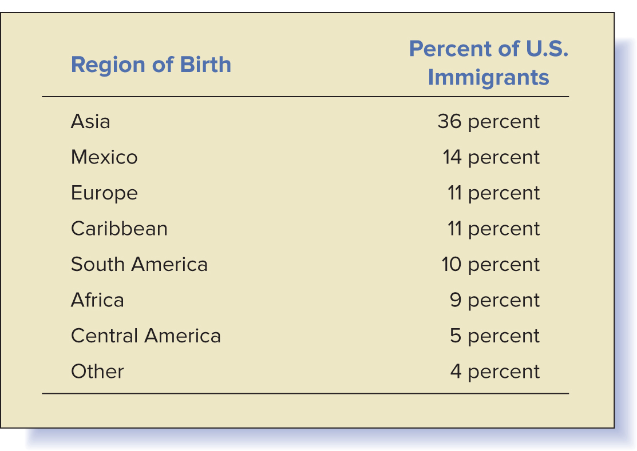
Charts

Slide 20
Charts
Help listeners visualize info
Show steps of process
Keep simple & clear
One could argue that the previous chart has a bit too much information to be simple, but it is still much better than the Ebola posters.

Slide 21
Video
Keep short (try for no more than 30-45 seconds, tops)
Cue to start of clip (have it pulled up and ready to go to avoid having to use speaking time to find the clip, find the spot, and then play it all during your speech)
Integrate smoothly (it should naturally fit in)
Avoid low-resolution (make sure it looks and sounds good)
It should go without saying, but make sure it is in English (I say this as a result of a Russian student who showed a news report on Chernobyl . . . in Russian. The clip was great, but people got so distracted by the foreign language that they did not pay attention. I told the speaker to consider just turning the volume down and telling the audience what they were seeing)

Slide 22
The Speaker
Use body to demonstrate procedure
Practice to coordinate words & actions

Slide 23
Presentation Tech.
Use strategically
Use to enhance specific points
Don’t overpower presentation
Don’t read from screen

Slide 24
Preparing Visual Aids
Prepare well in advance
Take time to not only proofread but to have others proofread it as well
Keep simple
Make large enough
Limit amount of text
Follow 7 by 7 Rule
No more than 7 lines of text per slide
No more than 7 words per line

Slide 25
Preparing Visual Aids
Use fonts effectively
Use color effectively
Use images strategically

Slide 26

Limited Text

Slide 27
Effective Fonts
Clear, easy to read
Normal case
Two per slide
Standardized across slides
Properly sized titles, body text

Slide 28
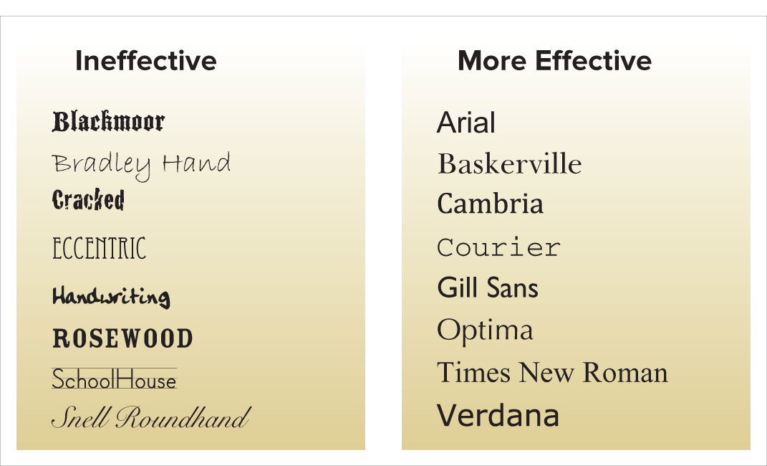
Effective Fonts

Slide 29
Effective Colors
High contrast
Easy to see
Limited number
Consistent across slides

Slide 30
Strategic Images
Large enough
High-resolution
Clear, simple
Title included on slide

Slide 31
Presenting Visual Aids
Display where listeners can see
Avoid passing
Display only while discussing
Explain clearly, concisely

Slide 32
Presenting Visual Aids
Talk to audience, not to visual aid
Talking to the visual is the most likely to occur with PowerPoint, particularly wordy ones (like this one!)
Practice with visual aids
Check room & equipment
For an online class, make sure that your visual shows up on your recording

